Slide 1
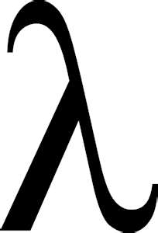

The silence of the
Unlocking the mysteries of advanced LINQ
Do you know how to read the syntax Clarice?
I only have partial methods and the rest is so static and generic…

Slide 2
FADE IN
INT.EMSG CONFERENCE ROOM
don-E clicks the next slide to display the topics slide.
DON-E: Today we are going to learn about Advanced LINQ

Slide 3
Agenda
More on control finder
The var Keyword
Anonymous/inline classes
Lambda expressions
Extensions
Different LINQ Syntax forms

Slide 4

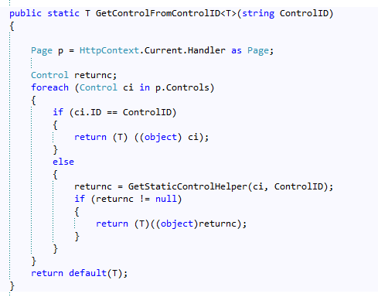
Yet another control Finder
I’m back!
Return what???

Slide 5
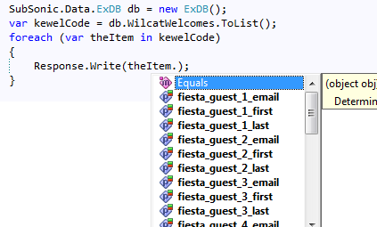
var-E kewel keyword
Dynamic typing
Gives intellisense
I know all about you

Slide 6
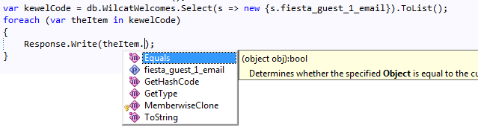
Looks like a duck…
I am not a duck!
Compiles exactly the same as using same type
So why use it?
Create a new type on the fly

Slide 7

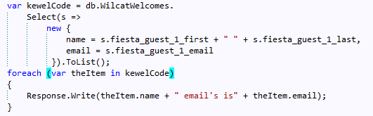
But wait there’s more…
Can rename columns
This creates a new class on the fly
This is called projection
Note you can move items for readability

Slide 8

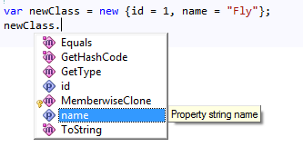
If you order right now…
Can also create classes inline
These also have intellisense
The previous are anonymous classes
Supports hierarchical data shaping

Slide 9

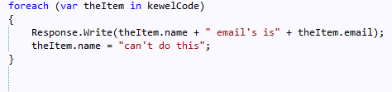
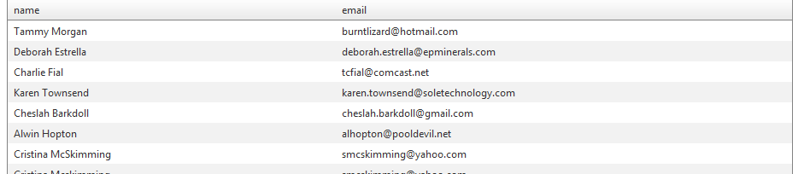
Can’t touch this
Values are immutable
But you can bind with this!

Slide 10

What the s=> s.IsThis?
Lambda expression
Let’s step back for a second
In LINQ you can write queries in multiple different ways but two main types
Fluent Syntax
Query Expression

Slide 11

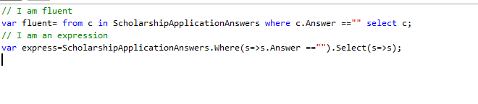
A tale of two queries
Fluent looks like dyslexic SQL
Expressions look like object methods
Some items like Distinct() can only be used in one form

Slide 12
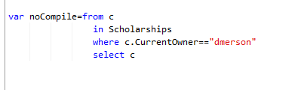
Fluent
I’m flew-ent!
Start off with “from <variable> in <linqobject>
This allows intellisense!
Always end with select
Usually are not compiled
Must end with ToList or it’s kin to compile

Slide 13
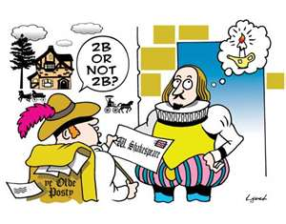
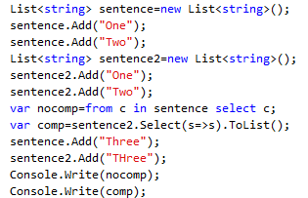
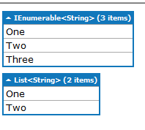
To compile or not compile

Slide 14

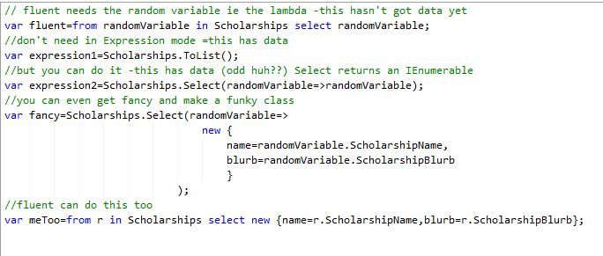
Lay the lambda down with the lion
Let’s play the same game

Slide 15

Quick Review
Fluent syntax must have select
Expression syntax need not have select
Fluent syntax must have a variable (the lambda)
Expression doesn’t need the lambda but can use it
Which to use????

Slide 16
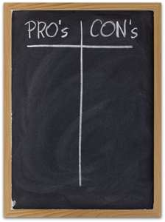
Some pros and cons
Expression syntax has items such as Distinct that you can use in fluent syntax
Fluent is easy to understand because it is SQL-ish
Expression syntax allows some pretty slick binding items
I prefer to mix em

Slide 17
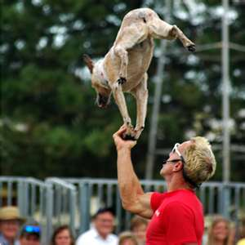
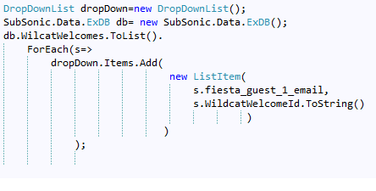
Neat tricks
Set up a list
Loop through it with the lambda via ForEach
Example populates a dropdown list
Now let’s answer the question..

Slide 18

What’s a lambda??
Based on functional calculus
A lambda expression is a concise delegate
A delegate is just a signature

Slide 19

Let’s use s
You set a variable (s)
So now s is whatever object you have at this point in the query
If you pulled back a list, s is the list
If you have one object, s is the object
Then do stuff with variable (s=>s.Answer==true)
These are all anonymous generic methods

Slide 20

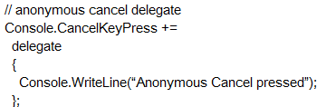
Anonymous methods
Write delegate { //stuff};
Just means non named method
Lamdba is a special case=>Extension Method

Slide 21

Different Lambda Expression formats
(input parameters)=>expression
(x,y)=> x==y
Optional parens if only one parameter
(int x, string s)=> s.Length > x
()=>SomeMethod()

Slide 22

More on the lamb
Func<T>
Static void methods that return values
Func<T,TResult>(T)
Send a type of T
Returns a TResult

Slide 23
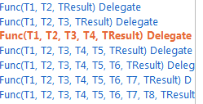
Func<T>
Has lots of overrides
Has output and input parameters
Func<Targ0,Targ1>(Targ0) returns Targ1
Func<string,int> turnToInt=s=>int.parse(s);
Int x=turnToInt(“1”);
The real power is being able to use generic types to reduce overloads

Slide 24

Func<T> methods
Func<T,T,Tresult> is a delegate
Create a function with signature
Things in brackets are Types
3 parameters means in, in, out
X and y goes in t0 function
( defines variables-implicit arguments)
=> action goes here
Now you can call it and returns value

Slide 25
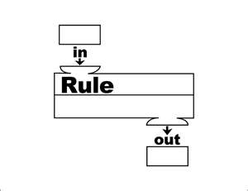
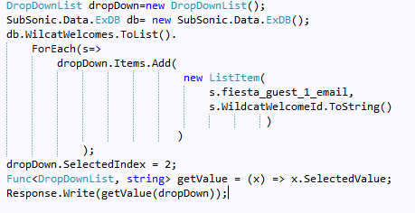
Our own function to get value

Slide 26

Let’s examine the litter
Old School
Send an object, get another back
Newer School
Create an anonymous delegate
Kewel School
Create a query expression(lambda)

Slide 27

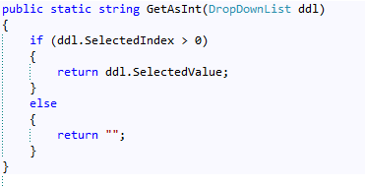
Old School
Send a object
Get an object back

Slide 28

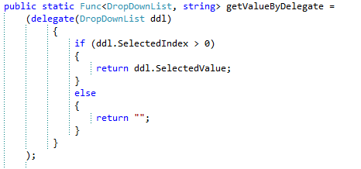
Nobody knows about me
Note first type becomes first argument
Returns second type
Note the parenthesis and ;

Slide 29


Lambda power
Take Func and go from there
Using ternary in this case
Could put in brackets

Slide 30

Why do we need this?
Old School works
But system is optimized to use short terse methods (See LINQ Unleashed)
Allows you to pass a generic object to work in multiple cases
Can’t do public string getThis(T objectToUse)
Must use object and then cast
LINQ allows parallel processing of loop structure

Slide 31
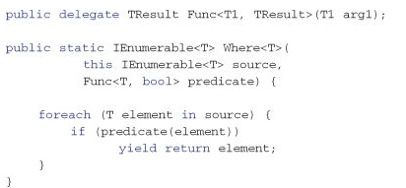
Where art thou T<Bird>?
Note that the T matches
Note the Func<T, bool>
Function that takes object and does something and returns results if true

Slide 32

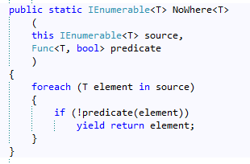

He’s a real nowhere man
Dumb but works
NoWhere in the System.LINQ
Doesn’t work in Fluent mode

Slide 33

Further examination
Note that the syntax says to declare the type
But we don’t have to because the compiler already figured it out
Thus we are just providing Func<T, bool>

Slide 34

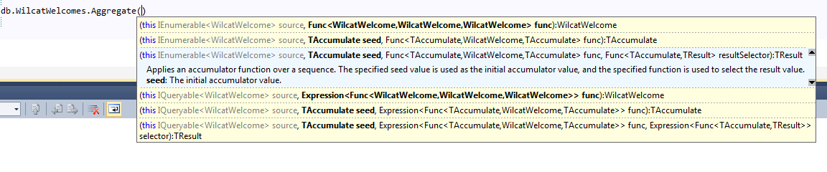
Oh yea, it knows…
Note that the syntax already filled in the type

Slide 35

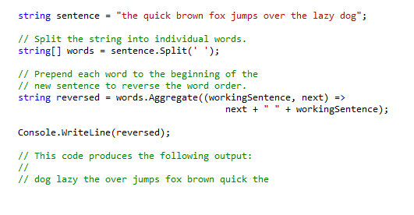
e.g.-
Workingsentence is variable
Next is variable for next record

Slide 36
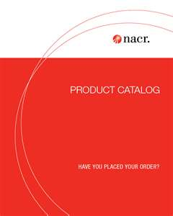
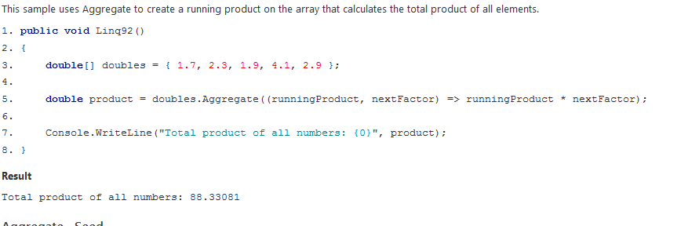
e.g.-
RunningProduct is current variable
nextFactor is variable for next record

Slide 37

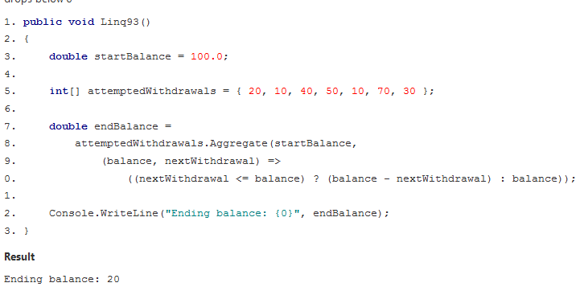
You got no more money
You pass startbalance (seed)
Balance is variable for current record
nextWithdrawal is variable for next record

Slide 38

If you make it there, you can make it anywhere
Aggregate is the most complex of the built in methods
If you can do it, the rest are easy

Slide 39

Extension Method Tips
Express the most limiting query first
Split each operator on a different line
Make as user friendly with line breaks and spacing to show hierarchy

Slide 40
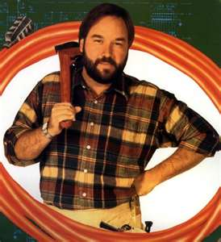
Why do this workshop?
Get understanding of odd syntax
Show the power of lambda
We have ability to use multicore processor
LINQ has built in abilities (Next workshop)
Next LINQ to XML and Parallel processing
Mostly importantly
<T>Bird wanted more attention
It’s all about me!

